Slide 1
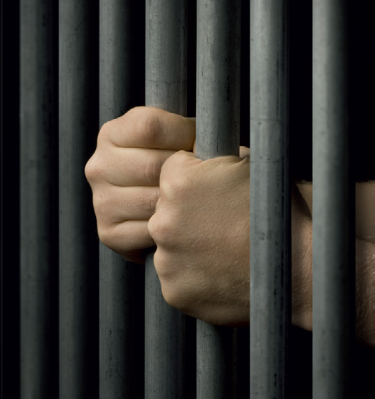
YOUTH CRIME
Drama
Lesson 4 and 5 – Documentary

Slide 2
Lesson Objectives:
To consolidate students’ knowledge of the differences between youth punishment and adult punishment.
To learn a variety of techniques to help create a persuasive argument in the form of a documentary.
Notes:
This scheme of work consists of a series of six lessons based on the exploration of youth crime. It is hoped that through practical exploration, students will gain a greater understanding of youth crime, the types of crimes that young people commit, and most importantly why. By the end of this scheme students will understand more about the law and young offenders, and the reasons behind young offenders committing crimes. Throughout these lessons students will be developing drama skills such as scriptwriting and forum theatre. The terminology and skills used are in line with the Edexcel GCSE specification.

Slide 3
Lesson Outcomes:
I will stay in role during tasks/activities/performances.
I will confidently perform a character different to myself during tasks/activities/performances.
I will confidently use drama techniques (Cross Cutting/Narration/Hot Seating) during my exploration.
I will use P.E.E.E.E.E. when evaluating my own work and the work of my peers.

Slide 4
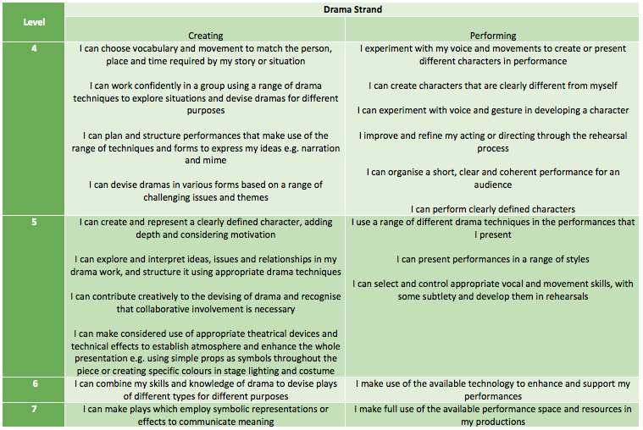
LESSON OUTCOMES

Slide 5
STARTER
3-15 Minutes

Slide 6

READ-A-FACT
Placards with facts on are displayed in the space.
It is your job to read the facts…you will need to make a decision on these facts so make sure you take a moment to digest the information

Slide 7
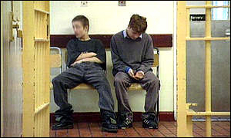
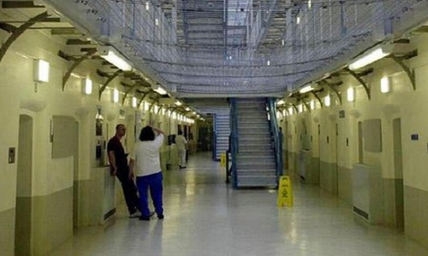
DECISION TIME
As a class let’s decide which fact belongs to which prison…
Does the fact belong to a Y.O.I.
Does the fact belong to an Adult prison

Slide 8
THE FACTS ARE…
YOI
There is a low staff to offender ratio.
The prisoners are expected to take part in at least 25 hours’ of education per week.
They have sessions aimed at helping them to improve their behaviour.
There are opportunities for prisoners to undertake work in Community Service Volunteer programmes. This might involve working with children with a disability or the elderly.
An induction session is organised for the first few days after an offender arrives at prison. This is an opportunity to talk through any concerns and issues as well as discussing opportunities for education and training during their sentence.
Adult Prison
More are in prison for ‘violence against the person’ than anything else.
Next in order are drug offences, burglary, robbery and sexual offences. These five categories account for the large majority of those in prison.
52 per cent of male prisoners and 71 per cent of female prisoners have no qualifications.

Slide 9
Do you think young offenders should have the same or different punishments as adult offenders?
SAME
DIFFERENT
On the wall are two lists, write your reason on your posit note and stick it to the paper lists provided.
Notes:
Create a table on the board/walls to fill in during discussions of FOR and AGAINST arguments. This will assist students in their documentary performance later in the lesson. For example, it could look like this: SAME PUNISHMENT = A crime is a crime, Age of criminal responsibility =10 yrs old, Need to be taught a lesson. DIFFERENT PUNISHMENT = Children may not understand/realise they have broken the law, Crime may be an accident, Peer pressure, Children should be educated, Idea of 2nd chance

Slide 10
WARM UP
15-25 Minutes

Slide 11
EXPLORATIVE STRATEGIES
Strategies we will look at today…
Cross-cutting: changing the order of scenes (like a flashback).
Hot seating: interviewing someone (asking/answering questions in role).
Narration: talking directly to the audience.

Slide 12

LOOK FOR THE STRATEGIES…

Slide 13
STOP & QUIZ!
“The aim of a documentary is to inform and educate the audience.”
What would you expect to have in a documentary?
Presenter; CCTV footage
/flashback; interviews; facts
Notes:
It is important that students understand the techniques used when making a documentary and how they can recreate them.

Slide 14
GROUP WORK
25 - 45 Minutes

Slide 15

GROUP TASK
In groups you must create a short documentary to show that young offenders should receive the same or different punishments to adult offenders.
Each group will receive a ‘FOR’ or ’AGAINST’ card and a planning sheet works.
Notes:
Teacher should now hand out ‘FOR’/’AGAINST’ cards and planning sheets and then explain/model

Slide 16
MUST HAVES…
Students will need to include the following:
A news presenter using narration.
A recreation of a crime or flashback (cross-cutting).
An interview with a victim, police officer, criminal, etc, using hot seating. (Or an interview with Marcus in the YOI.)
There should be tidy transitions between scenes, during which the presenter may want to speak.
Notes:
Display the list of things to be included to help students with their planning. While students are planning, circulate among the groups to ensure they all understand the task. If students are happier to just begin rehearsing without using the planning sheet, they may do so. Some students, however, will find this structure useful. This task could be carried into the next lesson in order to form a larger assessed performance.

Slide 17
PERFORM/EVALUATE
45 - 55 Minutes

Slide 18
PERFORM/FEEDBACK
Some groups will perform
Students are to give peer feedback using P.E.E.E.E.E
Students are to consider how cross-cutting, hot seating and narration have been used to show the groups argument.
REMEMBER
Point (E)
Example (D)
Explain (C)
Explore (C/B)
Expand (B/A)
Evaluate (A)

Slide 19
PLENARY
55 -60 Minutes

Slide 20
QUESTION TIME
As a whole class let’s think about this…
Have any of the news reports you’ve seen changed your opinion of youth punishments?
Did they manage to persuade you to think differently?

Slide 21
HOW DID YOU DO TODAY?

Slide 22
LESSON OUTCOMES
I will stay in role during tasks/activities/performances.
I will confidently perform a character different to myself during tasks/activities/performances.
I will confidently use drama techniques (Cross Cutting/Narration/Hot Seating) during my exploration.
I will use P.E.E.E.E.E. when evaluating my own work and the work of my peers.

Slide 23
LESSON OUTCOMES ADD LEVELS and DIFFERENTIATION
I will stay in role during tasks/activities/performances.
I will perform a character different to myself during tasks/activities/performances.
I will confidently use drama techniques (thought tracking/still image) during my exploration.
I will use P.E.E.E.E.E. when evaluating my own work and the work of my peers.

